Slide 1

Inheritance in Object-Oriented Programming
Course Title : Object Oriented Programming Course Code : CSE 221 Program : B.sc in Computer Science and Engineering Faculty : Faculty of Science and Information Technology Semester : Fall 2024
Present To:
Hasnur Jahan
Lecturer
Department of CSE
Daffodil International University

Slide 2

Team Members
Abrar Hasnat (0242310005101269)
Md Khaled Hasan (0242310005101262)
MD. Biltu Hossen (0242310005101471)
Nayem Bin Newas (0242310005101521)
Anika Anjum Reya (0242310005101733

Slide 3

What is Inheritance?
Inheritance is a core concept in Object-Oriented Programming (OOP) where a new class (subclass) derives properties and behaviors from an existing class (superclass). It enables code reuse and establishes a hierarchy between classes. This relationship allows child classes to extend or modify the functionality of the parent class.

Slide 4
Role of Inheritance in Hierarchies
Code Reusability: Inherited attributes and methods reduce redundancy, allowing new classes to build on existing ones without rewriting code.
Hierarchical Structure: Enables a logical organization where classes are arranged in levels, reflecting real-world relationships and dependencies.
Polymorphism: Allows different classes to be treated as instances of a parent class, enabling flexibility in handling different objects with a common interface.

Slide 5
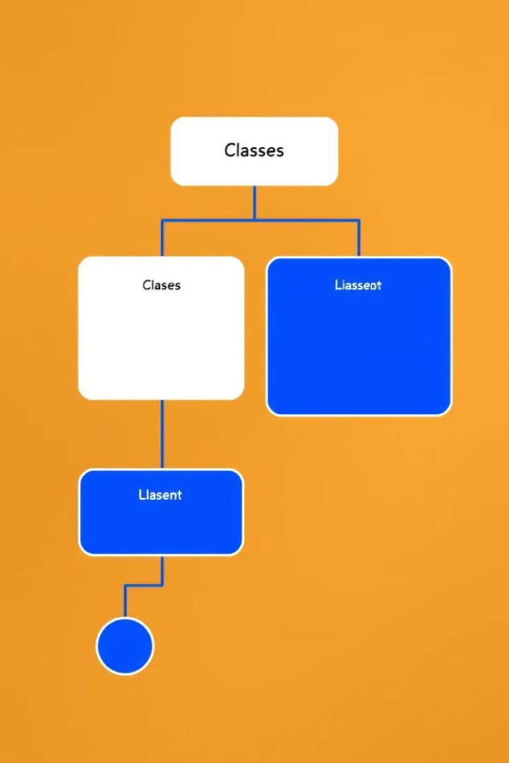
Superclass and Subclass Relationships
1
Superclass
The parent class, or base class, provides common features for its children.
2
Subclass
The child class, or derived class, receives features from the parent and can add its own.
3
Hierarchical Relationships
Inheritance creates a tree-like structure, where subclasses can inherit from other subclasses.

Slide 6
Inheriting Attributes and Behaviors
Attribute Inheritance
Behavior Inheritance
Method Overriding
Subclasses get attributes from their parent class.
Subclasses get methods from their parent class.
Subclasses can change how inherited methods work.

Slide 7
Parent Class and Child Class Relationship
A child class inherits attributes and methods from a parent class, enabling code reuse and logical structuring.
Example Code
// Parent Class
class Shape {
String color;
void draw() {
System.out.println("Drawing a " + color + " shape.");
}
}
// Child Class
class Circle extends Shape {
double radius;
void calculateArea() {
double area = Math.PI * radius * radius;
System.out.println("Area of the circle: " + area);
}
}
// Usage
public class Main {
public static void main(String[] args) {
Circle circle = new Circle();
circle.color = "red"; // Inherited attribute
circle.radius = 5.0; // Child-specific attribute
circle.draw(); // Inherited method
circle.calculateArea(); // Child-specific method
}
}

Slide 8
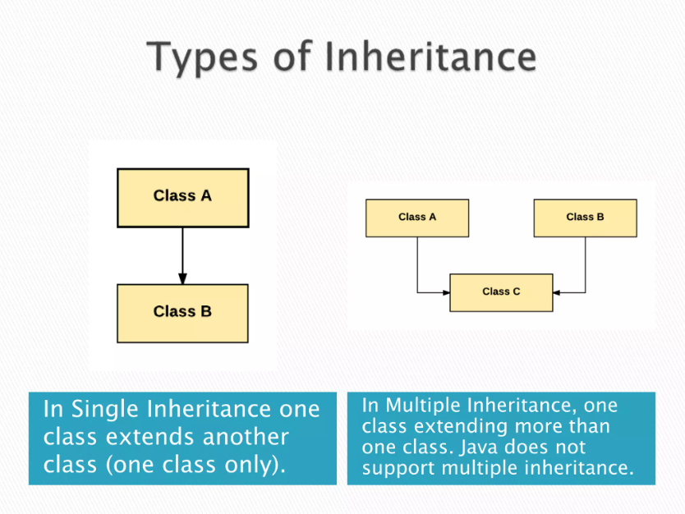
Single Inheritance vs. Multiple Inheritance
1
Single Inheritance
2
Multiple Inheritance
A subclass inherits from one superclass.
A subclass inherits from multiple superclasses.
3
Language Support
Some languages, like Java, only support single inheritance, while others, like C++, allow for both single and multiple inheritance.

Slide 9
Difference between single inheritance and multiple inheritance
// Parent Class
class Vehicle {
String brand = "Toyota";
void drive() {
System.out.println(brand + " is driving.");
}
}
// Child Class (Single Inheritance)
class Car extends Vehicle {
int maxSpeed = 180;
void display() {
System.out.println(brand + " car with max speed: " + maxSpeed + " km/h.");
}
}
// Usage
public class Main {
public static void main(String[] args) {
Car car = new Car();
car.drive(); // Inherited method
car.display(); // Child-specific method
}
}
// Parent Class 1
class Vehicle {
void drive() {
System.out.println("Vehicle is driving.");
}
}
// Parent Class 2
class Aircraft {
void fly() {
System.out.println("Aircraft is flying.");
}
}
// Child Class (Attempting Multiple Inheritance)
class FlyingCar extends Vehicle, Aircraft { // ERROR: Java does not support multiple inheritance with classes.
void operate() {
System.out.println("FlyingCar is operating.");
}
}
// Usage
public class Main {
public static void main(String[] args) {
FlyingCar flyingCar = new FlyingCar();
flyingCar.drive(); // Error: 'FlyingCar' cannot inherit from multiple classes.
flyingCar.fly(); // Error: 'FlyingCar' cannot inherit from multiple classes.
flyingCar.operate();
}
}

Slide 10
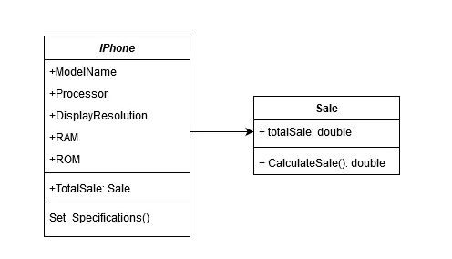
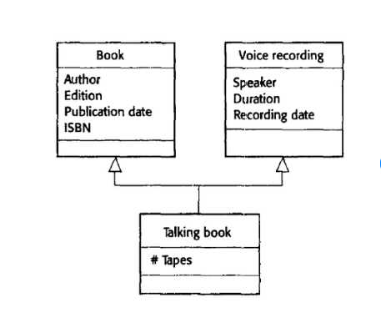
Single Inheritance
multiple inheritance

Slide 11
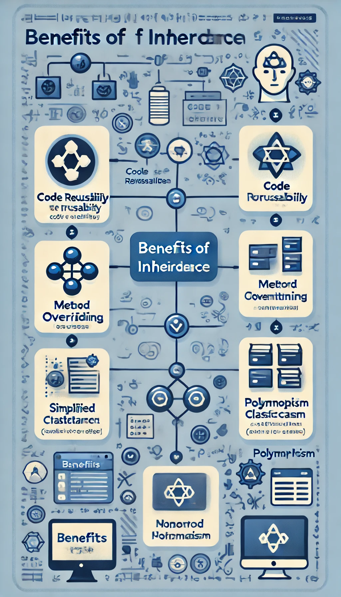
Benefits of Inheritance
Reusing Code
Clear Structure
Saves time and effort by reusing code.
Organizes code into a hierarchy, making it easy to understand.
Flexible Behavior
Focus on the Big Picture
Supports polymorphism for unique behavior.
Simplifies code by focusing on high-level concepts.

Slide 12

Thank You

